Slide 1
The cell biology lab 10
Lysosomes

Slide 2
Lysosomes are spherical organelles that contain enzymes (acid hydrolases). They break up food so it is easier to digest. They are found in animal cells, while in yeast and plants the same roles are performed by lytic vacuoles.
-The size of lysosomes varies from 0.1–1.2 μm.
- Lysosomes are sometimes called (suicide bags)
- To digest food, the lysosome membrane fuses with the membrane of a food vacuole and squirts the enzymes inside.
- The digested food can then diffuse through the vacuole membrane and enter the cell to be used for energy or growth.

Slide 3
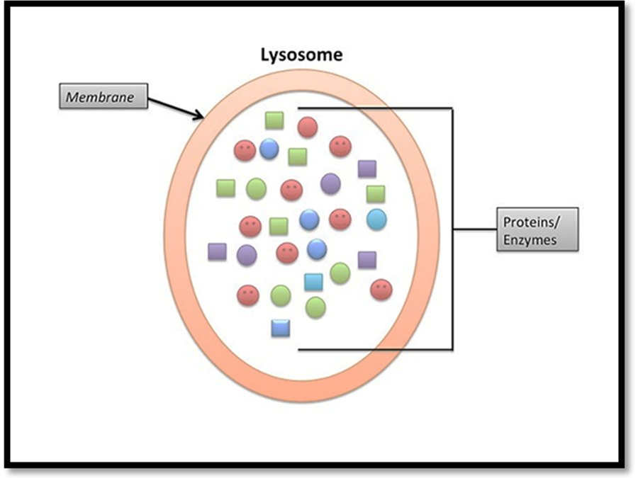

Slide 4
Some important enzymes found within lysosomes include:
Lipase, which digests lipids .
Amylase, which digest carbohydrates (e.g., sugars).
Proteases, which digest proteins.
Nucleases, which digest nucleic acids
All these hydrolytic enzymes are produced in the endoplasmic reticulum, and to some extent in cytoplasm are transported and processed through the Golgi apparatus , then they pinch off as single membrane vesicles.

Slide 5
